Slide 1
Kubernetes Workshop: Develop and Deploy a Microservices Application on Kubernetes
Dell Technologies Educations Services

Slide 2
Workshop Agenda
DAY 2
Deploying containerized workloads on Kubernetes with pipeline
Persisting data in Kubernetes using PV & PVC
Logging and Monitoring

Slide 3
Build CI/CD Pipeline for your Containers
Notes:
3
08-07-2020

Slide 4
Release Process Stages
Source
Build
Test
Production
Check in source code
Get Peer review done
Compile code
Unit Tests
Style Checkers
Build and push container images
Integration Tests with other systems
Load Testing
UI Tests
Security Testing
Deployment to production
Environments
Monitor code in production
to quickly detect errors
Continuous Integration
Continuous Deployment

Slide 5

Release Process Stages
Source
Build
Test
Production
Check in source code
Get Peer review done
Compile code
Unit Tests
Style Checkers
Build and push container images
Integration Tests with other systems
Load Testing
UI Tests
Security Testing
Deployment to production Environments
Monitor code in production
to quickly detect errors
Continuous Integration
Continuous Delivery

Slide 6
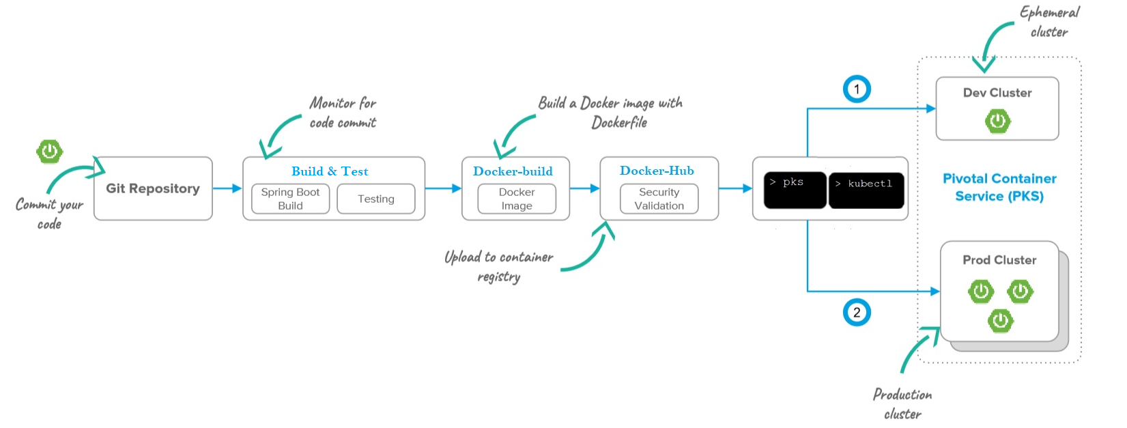

Continuous Deployment to PKS
Github Actions

Slide 7
Lab 5: Buid Pipeline with Github Actions

Slide 8
Understanding Persistent Storage in Kubernetes
Notes:
Bob - v,sc
Jeff - pv,pvc

Slide 9
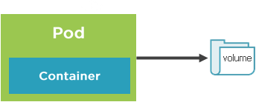
Storage Core Concepts
Pods live and die so their file system is short lived(ephemeral)
Volumes can be used to store state/data and use it in pod
A pod can have multiple volumes attached to it.
Containers rely on a mount path to access a volume
Kubernetes supports :
Volumes
PersistentVolumes
PersistentVolumesClaims
StorageClasses

Slide 10
Volumes and Volume mounts
A volume references a storage location
Must have a unique name
Attached to pod and may or may not be tied to the Pod’s lifetime
Attached to pod and may or may not be tied to the Pod’s lifetime(depending on the volume types )
A volume mount references a volume by name and defines a mountPath

Slide 11
Volume type examples
emptyDir – Empty directory for storing “transient” data (shares a Pod’s lifetime) useful for sharing files between containers running in a Pod
hostPath – Pod mounts to the node’s file system
nfs – A Network file system share mounted into the Pod
configMap/Secret – Special types of volumes that provide a Pod with access to Kubernetes resources
persistentVolumeClaim - Special types of volumes that provide a Pod with access to Kubernetes resources
Cloud – cluster wide storage

Slide 12
Volume Types
awsElasticBlockStore
azureDisk
azureFile
cephfs
configMap
csi
downwardAPI
emptyDir
fc (fibre channel)
flocker
gcePersistentDisk
gitRepo
glusterfs
hostPath
iscsi
local
nfs
persistentVolumeClaim
projected
portworxVolume
quobyte
rbd
scaleIO
secret
storageos
vsphereVolume

Slide 13
Defining an emptyDir Volume
apiVersion: v1
kind: Pod
spec:
volumes:
-name: html
emptyDir: {}
containers:
-name: nginx
image: nginx:alpine
volumeMounts:
-name: html
mountPath: /usr/share/nginx/html
readOnly: true
-name: html-updater
image: alpine
command: ["/bin/sh", "-c"]
args:
-while true; do date >> /html/index.html; sleep 10; done
volumeMounts:
-name: html
mountPath: /html
Define initial Volume named “html” that is an empty directory(lifetime of the Pod
Reference “html” Volume and define a mountPath
Update file in Volume mount /html path with latest date every 10 seconds
Reference “html” Volume (defined above) and define a mountPath

Slide 14
Persistent volumes
A Persistent volume is cluster-wide storage resource that relies on network-attached storage(NAS)
Normally provisioned by cluster administrator
Available to a pod even if it gets rescheduled to a different node
Rely on a storage provider such as NFS, cloud storage, or other options
Associated with a Pod by using a PersistentVolumeClaim(PVC)

Slide 15
PersistentVolumeClaim
A PersistentVolumeClaim (PVC) is a request for storage unit.
Satisfies a set of requirements instead of mapping to a storage resource directly.
Ensures that an application’s ‘claim’ for storage is portable across numerous backends or providers.

Slide 16
PersistentVolume Workflow
Define a persistence volume(PV) and send to the Kubernetes API
Create a PersistentVolumeclaim(PVC)
Kubernetes binds the PVC to PV
Pod volume references the PVC
Create network storage resource(NFS ,Cloud etc.

Slide 17
PersistentVolume
capacity.storage: The total amount of available storage.
volumeMode: The type of volume, this can be either Filesystem or Block.
accessModes: A list of the supported methods of accessing the volume. Options include:
ReadWriteOnce
ReadOnlyMany
ReadWriteMany
apiVersion: v1
kind: PersistentVolume
metadata:
name: nfsserver
spec:
capacity:
storage: 50Gi
volumeMode: Filesystem
accessModes:
- ReadWriteOnce
- ReadWriteMany
persistentVolumeReclaimPolicy: Delete
storageClassName: slow mountOptions:
- hard
- nfsvers=4.1
nfs:
path: /exports
server: 172.22.0.42

Slide 18
PersistentVolume
persistentVolumeReclaimPolicy: The behaviour for PVC’s that have been deleted. Options include:
Retain - manual clean-up
Delete - storage asset deleted by provider.
storageClassName: Optional name of the storage class that PVC’s can reference. If provided, ONLY PVC’s referencing the name consume use it.
mountOptions: Optional mount options for the PV.
apiVersion: v1
kind: PersistentVolume
metadata:
name: nfsserver
spec:
capacity:
storage: 50Gi
volumeMode: Filesystem
accessModes:
- ReadWriteOnce
- ReadWriteMany
persistentVolumeReclaimPolicy: Delete
storageClassName: slow mountOptions:
- hard
- nfsvers=4.1
nfs:
path: /exports
server: 172.22.0.42

Slide 19
PersistentVolumeClaim
accessModes: The selected method of accessing the storage. This MUST be a subset of what is defined on the target PV or Storage Class.
ReadWriteOnce
ReadOnlyMany
ReadWriteMany
resources.requests.storage: The desired amount of storage for the claim
storageClassName: The name of the desired Storage Class
kind: PersistentVolumeClaim
apiVersion: v1
metadata:
name: pvc-sc-example
spec:
accessModes:
- ReadWriteOnce
resources:
requests:
storage: 1Gi
storageClassName: slow

Slide 20
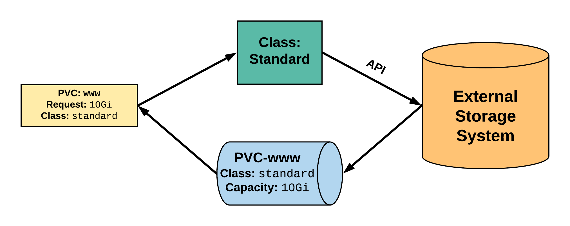
StorageClass
2. StorageClass provisions request through API with external storage system.
1. PVC makes a request of the StorageClass.
uid: 9df65c6e-1a69-11e8-ae10-080027a3682b
4. provisioned PV is bound to requesting PVC.
3. External storage system creates a PV strictly satisfying the PVC request.
pv: pvc-9df65c6e-1a69-11e8-ae10-080027a3682b
Notes:
A PVC is created with a storage request and supplies the StorageClass ‘standard’
The storageClass ‘standard’ is configured with some information to connect and interact with the API of an external storage provider
The external storage provider creates a PV that strictly satisfies the PVC request. Really, it means it’s the same size as the request
The PV will be named pvc-<uid of the pvc>
The PV is then bound to the requesting PVC

